Slide 1
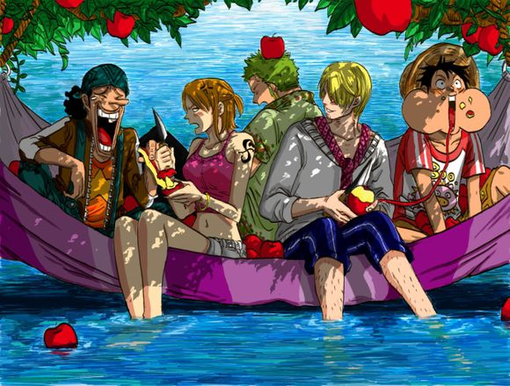
ANIME

Slide 2
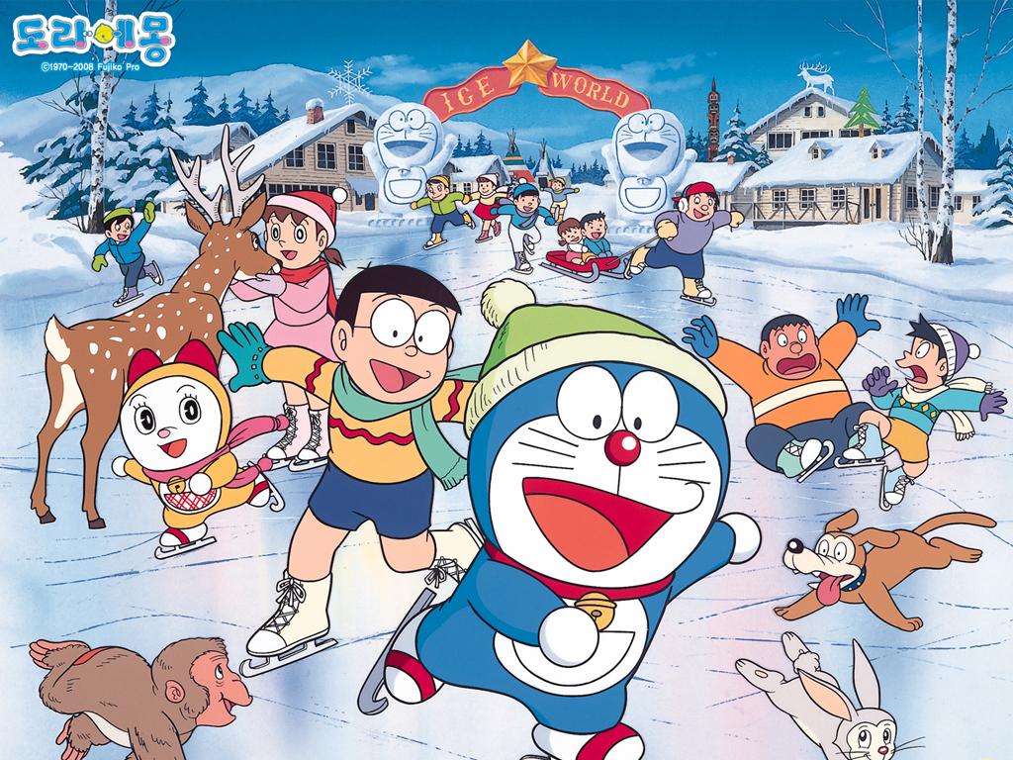
Doraemon

Slide 3

What is anime?
Fiction

Slide 4



Slide 5


Slide 6
What is anime?
Fiction
Combination

Slide 7
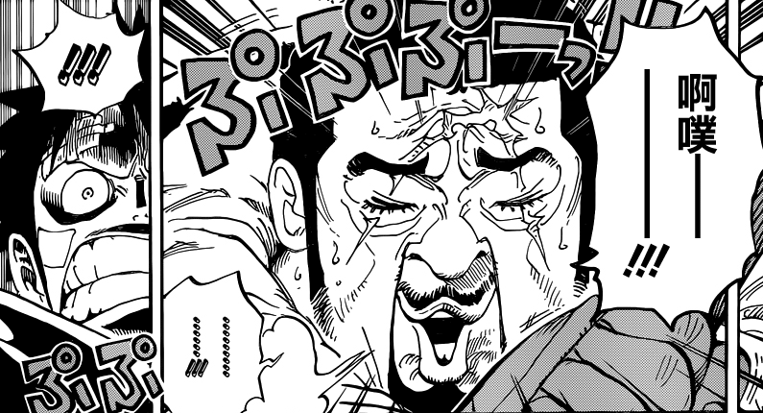
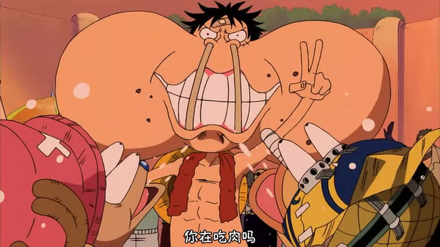
comic
Anim
ation

Slide 8
What is anime?
Fiction
Combination
More beautiful character

Slide 9
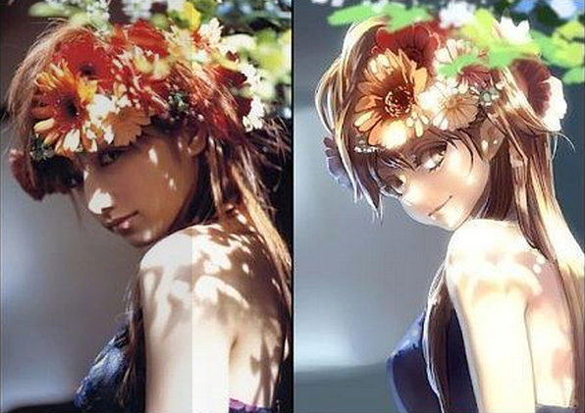
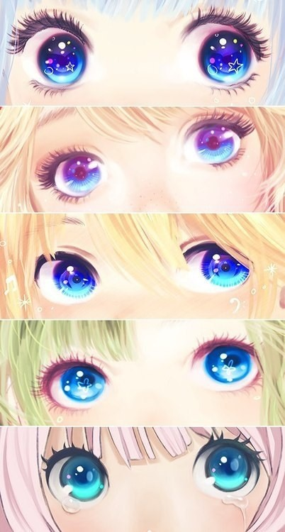


Slide 10
Variety of anime
WAR SUPER POWER
ROBOT TALES
ADVENTURE HISTORY
YOUTH EMOTION
CHARMING GIRLS DAILY LIFE
CHARMING BOYS SCHOOL
PETS SUSPENSE
KNIFE AND SWORD DESTRUCTION
MAGIC ETC.

Slide 11
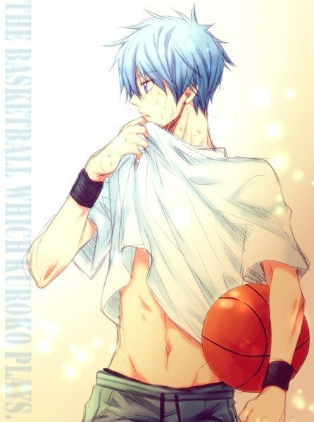
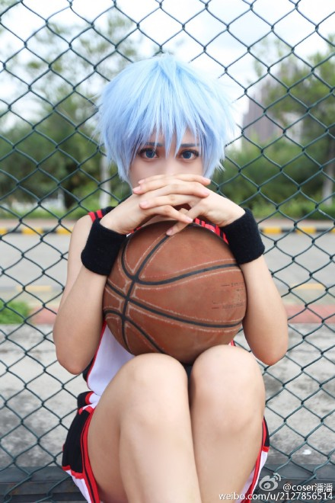
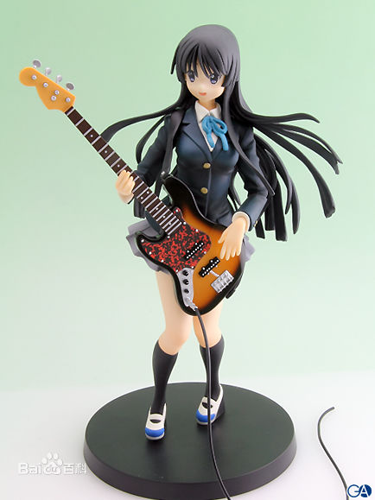
A few specific words for anime
cosplay
Garage kit（GT）
ACG

Slide 12

ACG
animation
comic
game

Slide 13
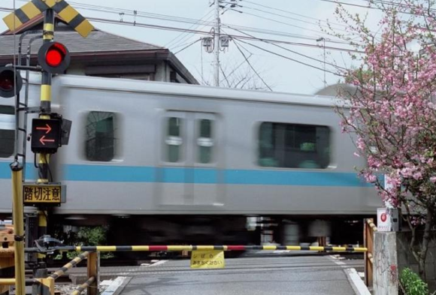
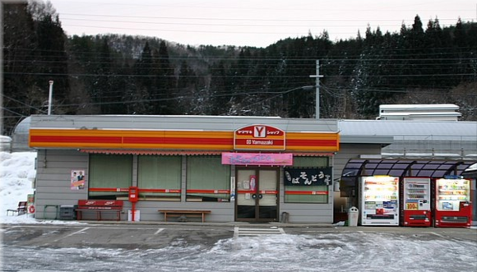
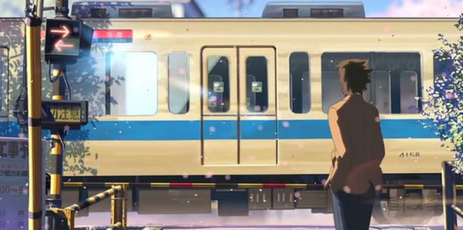
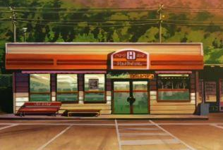
Real places appeared in anime

Slide 14

The final part
RECOMMENDATION:
One Piece
Naruto
The flower we saw that day
The Pet Girl of Sakurasou

Slide 15
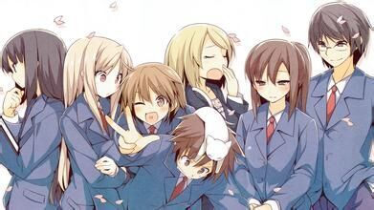
THANKS FOR WATCHING

